Slide 1
Propositional logic

Slide 2
Proposition
A proposition is a declarative statement that is either true or false but not both.
Every proposition has a single truth value, that being either true or false.

Slide 3
Proposition examples
Greater Male is the capital of the Maldives.
Today is Monday
It is dark outside.

Slide 4
These are not propositions
Read this carefully.
x + 1 = 2.
What time is it?

Slide 5


Find out the PROPOSITIONS!
4 is a prime number
Are you leaving?
3+3=6
Buy four books
X+Y>4
Children like sweet
The moon is made of cheese

Slide 6
SYMBOLIC LOGIC

Slide 7
Logic Operators in Symbolic Logic
Symbolic Logic is a Propositional Logic whereby symbols replace propositions and logical operators.
¬𝑃 represents ‘not 𝑃’
𝑃∧𝑄 represents ‘𝑃 and 𝑄’[cap(∧ - n)]
𝑃∨𝑄 represents ‘𝑃 inclusive-or 𝑄’[cup(∨ - r)]
𝑃⊕𝑄 represents ‘𝑃 exclusive-or 𝑄’
𝑃→𝑄 represents ‘𝑃 implies 𝑄’
𝑃 𝑄 represents ‘𝑃 biconditional 𝑄’
↔

Slide 8
Conjunction operator - P∧Q
P | Q | P∧Q
0 | 0 | 0
0 | 1 | 0
1 | 0 | 0
1 | 1 | 1
P | Q | P∧Q
F | F | F
F | T | F
T | F | F
T | T | T
P∧Q will be true iff (if and only if) both p and q are true.
E.g.: Kaafu is an atoll in Maldives and Milaidhoo is an island in Maldives

Slide 9
Disjunction operator - P∨Q
P | Q | P∨Q
0 | 0 | 0
0 | 1 | 1
1 | 0 | 1
1 | 1 | 1
P | Q | P∨Q
F | F | F
F | T | T
T | F | T
T | T | T
P∨Q be true iff either p is true, or q is true, or both p and q are true.
Eg: Rose is red or snow is white

Slide 10
Exclusive OR - P⊕Q
P ⊕ Q= (P ∧¬ Q) ∨( ¬ P ∧ Q)
P ⊕ Q, is true when exactly one of P and Q is true and is false otherwise.
E.g.: Either you choose Computer Science or Biology in A level.
P | Q | P⊕Q
0 | 0 | 0
0 | 1 | 1
1 | 0 | 1
1 | 1 | 0
P | Q | P⊕Q
F | F | F
F | T | T
T | F | T
T | T | F

Slide 11
Implication operator- P→Q / P⊃Q
P | Q | P→Q
0 | 0 | 1
0 | 1 | 1
1 | 0 | 0
1 | 1 | 1
P | Q | P→Q
F | F | T
F | T | T
T | F | F
T | T | T
P is the premise/hypothesis/antecedent
Q is the conclusion/consequence
Conditional statement IF… THEN…
P→Q will be true iff either p is false,
or q is true.
Eg: a) If 1 + 1 = 2, then 2 + 2 = 5. FALSE
b) If 1 + 1 = 2, then 2 + 2 = 4. TRUE
c) If 1 + 1 = 3, then 2 + 2 = 5. TRUE
d) If monkeys can fly, then 1 + 1 = 2. TRUE

Slide 12
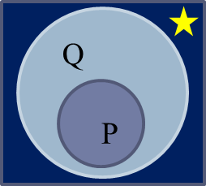
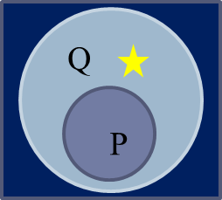
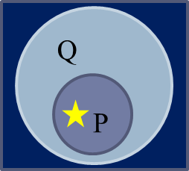
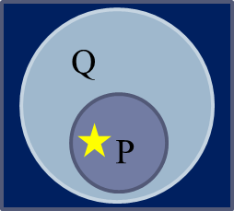
Implication operation
Consider the example
P : Ali is in Villa college
Q : Ali is in Male
P → Q : Ali is in villa college →Ali is in Male
Not Impossible
Not Impossible
Impossible
Not Impossible
P | Q | P→Q
F | F | T
P | Q | P→Q
F | T | T
P | Q | P→Q
T | F | F
P | Q | P→Q
T | T | T

Slide 13
Biconditional operator - P↔Q
P ↔ Q will be true iff either P and Q are both true or P and Q are both false.
P ↔ Q will be true under the same circumstances.
E.g. : It is raining and It is cold. (TRUE)
It is not raining and It is not cold (TRUE)
P | Q | P↔Q
0 | 0 | 1
0 | 1 | 0
1 | 0 | 0
1 | 1 | 1
P | Q | P↔Q
F | F | T
F | T | F
T | F | F
T | T | T

Slide 14
Recap
P | Q | P∧Q | P∨Q | P⊕Q | P→Q | P↔Q
F | F | F | F | F | T | T
F | T | F | T | T | T | F
T | F | F | T | T | F | F
T | T | T | T | F | T | T

Slide 15
ASSIGNMENT IS UPLOADED IN MOODLE

Slide 16
Propositional Logic: Syntax and Semantics
Syntax : rules to determine whether an expression is an acceptable formula.
E.g. In algebra, 𝑥+(𝑦−𝑧) correct syntax but 𝑦𝑥(𝑧−)+ is not.
In logic p∧q ∧ r is correct but p ∧ q ∧ r∨ is not
Semantics : the meaning of a formula
what does the formula represent
what are its values
.

Slide 17
Calculation of Truth Values
Given that P, Q and R are assigned the truth values, T, F and F respectively
Ex 1 ¬(𝑃∧𝑄)→𝑅
Ex 2 (¬𝑃)∧(𝑄→𝑅)
¬(𝑻∧𝑭)→𝐹
¬𝑭→𝐹
𝑻→𝐹
𝑭
(¬𝑻)∧(𝑭→𝐹)
𝑭∧𝑇
𝑭

Slide 18
TRUTH TABLE

Slide 19
Interpretation
Interpretation is an allocation of truth values to the propositional variables in the propositional formula.
Consider a proposition P then
Assigning P a truth value of True or False is interpretation
If P= True, then interpretation is said to be a model for the formula.
If P= False then the interpretation is said to be a countermodel for the formula.

Slide 20
Constructing Truth Tables
The truth table will contain,
Rows-all the possible interpretations
Columns-unique proposition variables and formula
Number of rows(interpretation)=2^{N} where N is the number of proposition variables
N=2 [P and Q]
No. of rows = 2^{N}= 2² = 4
COLUMNS
P | Q | P∨Q | (P∨Q) ∧Q | ¬((P∨Q) ∧Q )
F | F | F | F | T
F | T | T | T | F
T | F | T | F | T
T | T | T | T | F
4 ROWS

Slide 21
Exercise 1
.
P | Q | P→Q | (P→Q)→P
F | F
F | T
T | F
T | T
P | Q | P∨Q | (P∨Q) ∧P
F | F
F | T
T | F
T | T
(𝑃→𝑄)→𝑃
T F
T F
F T
T T
F F
T F
T T
T T
(𝑃∨𝑄)∧𝑃

Slide 22
Thank you!

